Slide 1


Slide 2
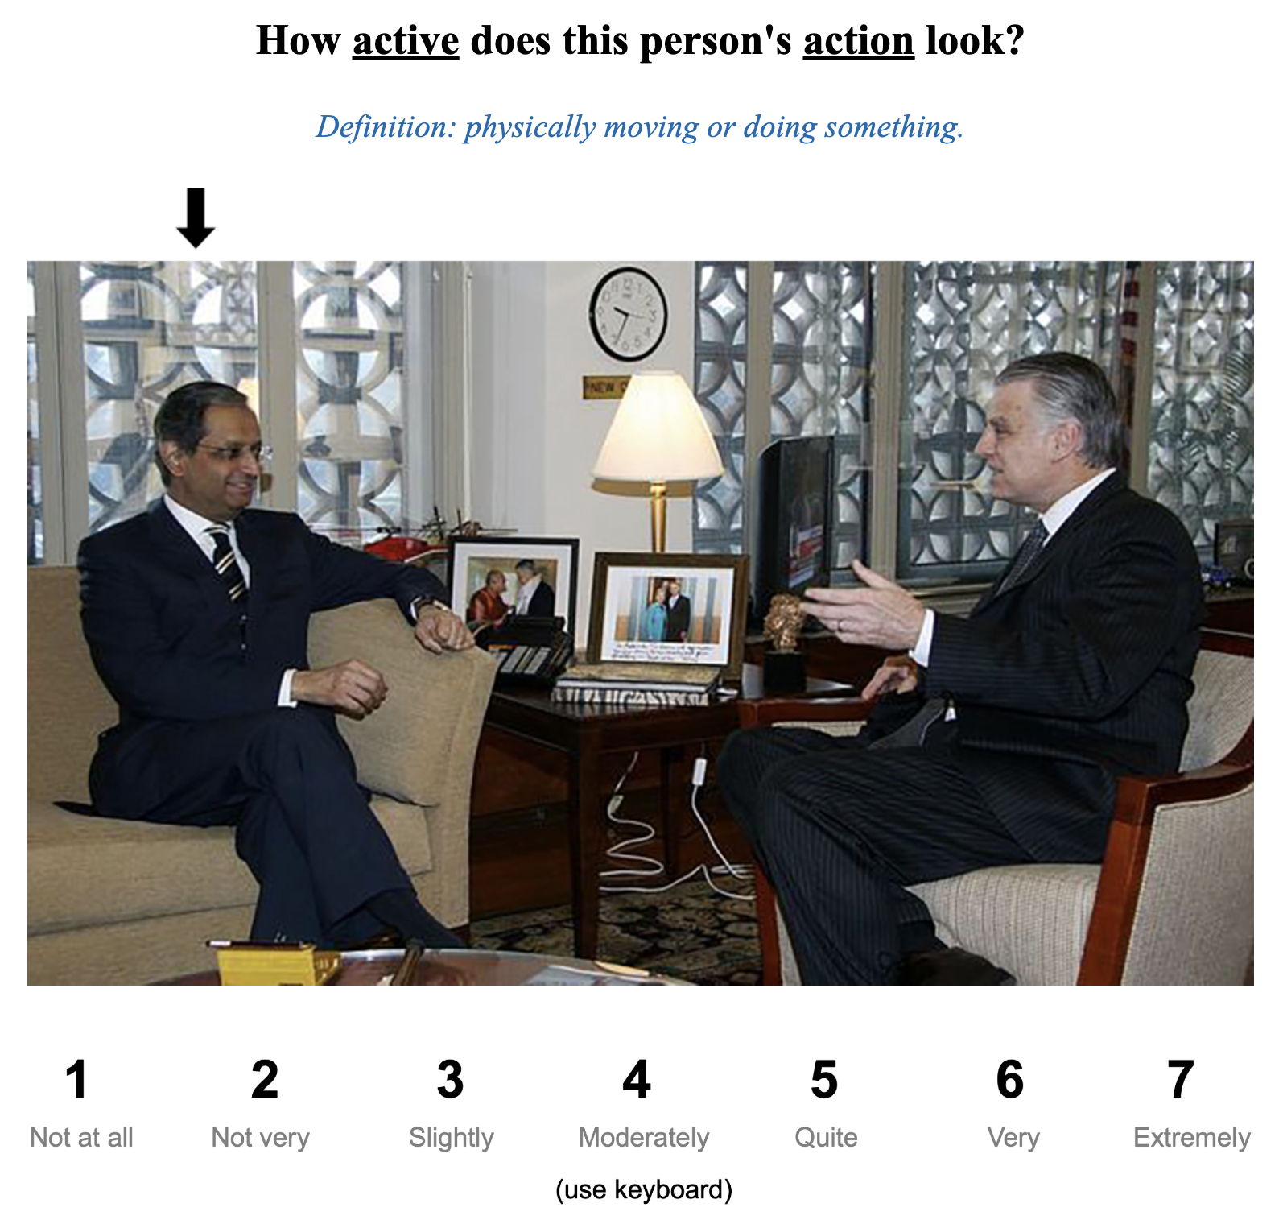

Slide 3
1
2
3
4
5
6
7
Not at all
Not very
Slightly
Moderately
Quite
Very
Extremely
(use keyboard)

Slide 4
1
7
Left image
Right image
(use keyboard)

Slide 5
1
7
Left image
Right image
(use keyboard)

