Slide 1


Slide 2
How dominant is this person?
Definition: a person who has the tendency to exert control or influence over others in a group or situation.

Slide 3
How warm is this person?
Definition: a person who has, shows, or expresses enthusiasm, affection, or kindness.

Slide 4
How competent is this person?
Definition: a person who is efficient and capable to do things in general.

Slide 5
How feminine is this person?
Definition: a person whose physical appearance or behavior looks like a woman.

Slide 6
How youthful is this person?
Definition: a person whose physical appearance or behavior looks like a young person.

Slide 7
How attractive is this person?
Definition: a person who looks physically appealing.

Slide 8
How open is this person?
Definition: a person who is motivated to seek new experiences and consider new ideas.

Slide 9
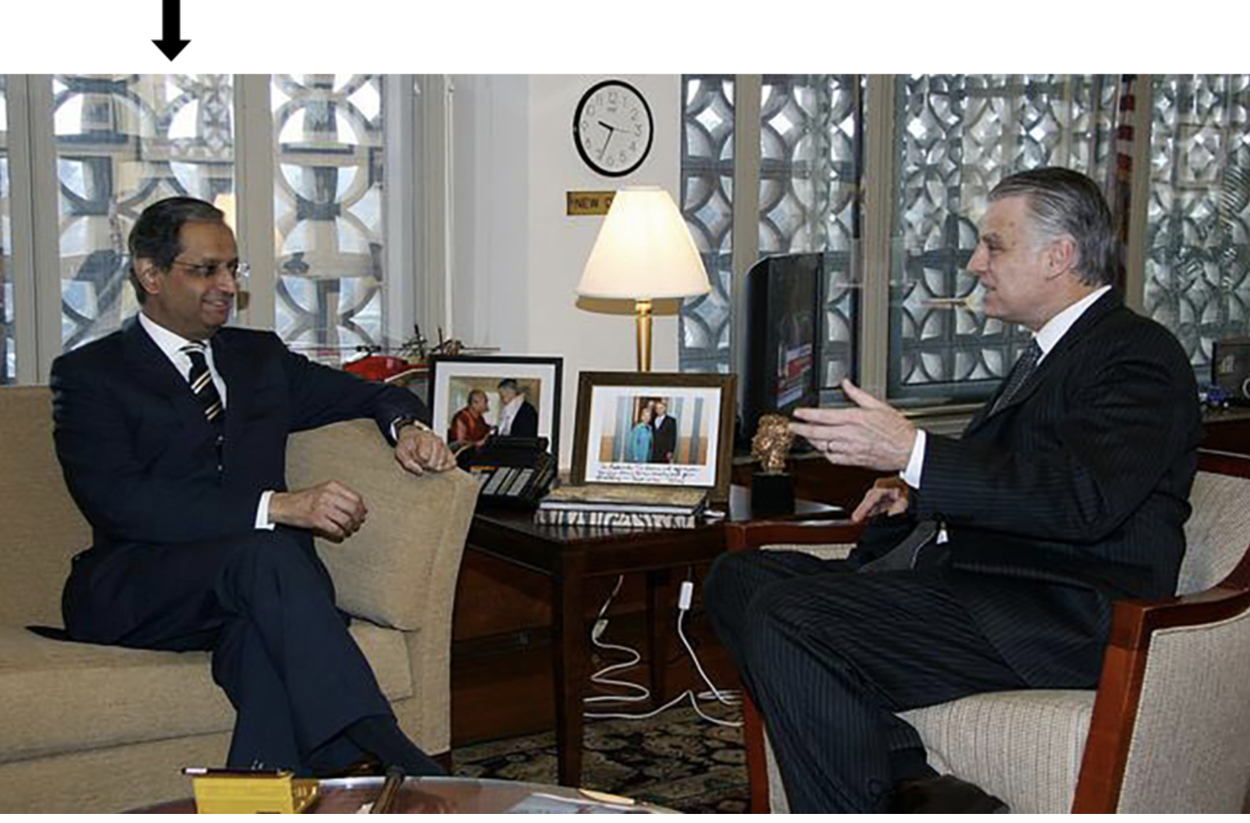
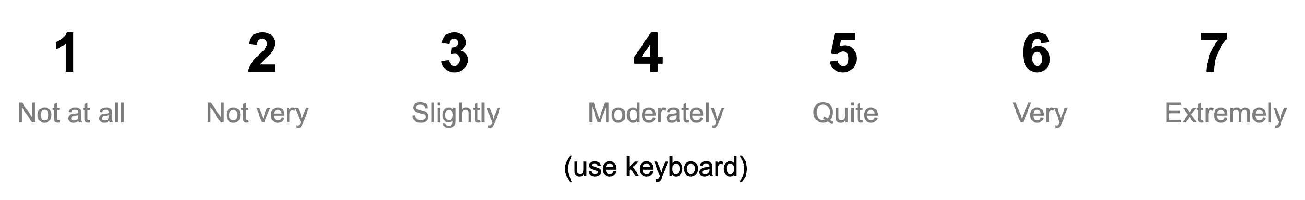
How dominant is this person?
Definition: a person who has the tendency to exert control or influence over others in a group or situation.

Slide 10
How warm is this person?
Definition: a person who has, shows, or expresses enthusiasm, affection, or kindness.

Slide 11
How competent is this person?
Definition: a person who is efficient and capable to do things in general.

Slide 12
How feminine is this person?
Definition: a person whose physical appearance or behavior looks like a woman.

Slide 13
How youthful is this person?
Definition: a person whose physical appearance or behavior looks like a young person.

Slide 14
How attractive is this person?
Definition: a person who looks physically appealing.

Slide 15
How open is this person?
Definition: a person who is motivated to seek new experiences and consider new ideas.

Slide 16
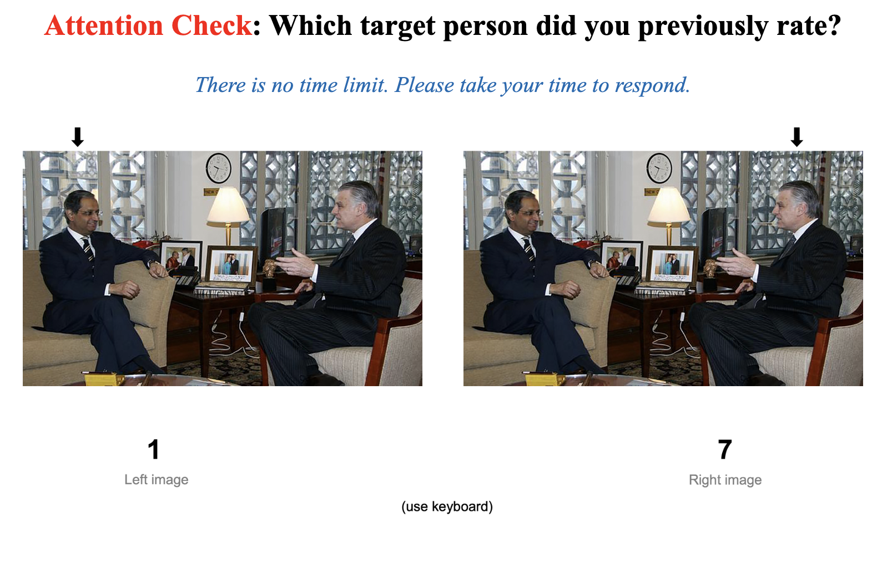

Slide 17
1
2
3
4
5
6
7
Not at all
Not very
Slightly
Moderately
Quite
Very
Extremely
(use keyboard)

Slide 18
1
7
Left image
Right image
(use keyboard)

Slide 19
1
7
Left image
Right image
(use keyboard)

