Slide 1


Slide 2
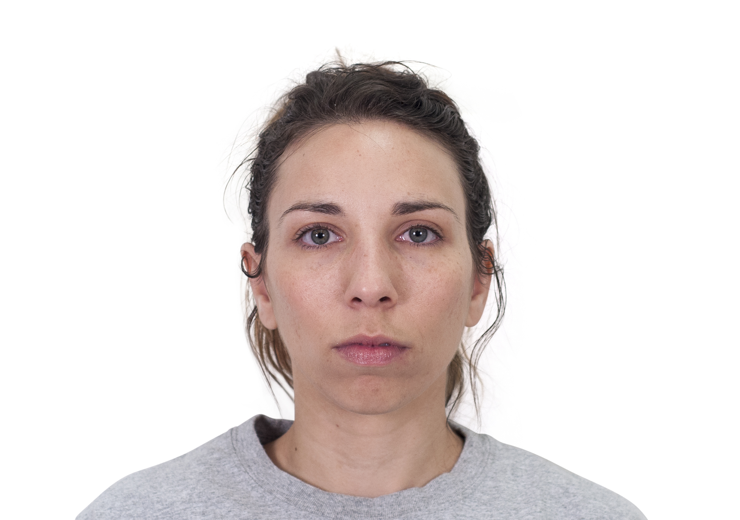


Slide 3
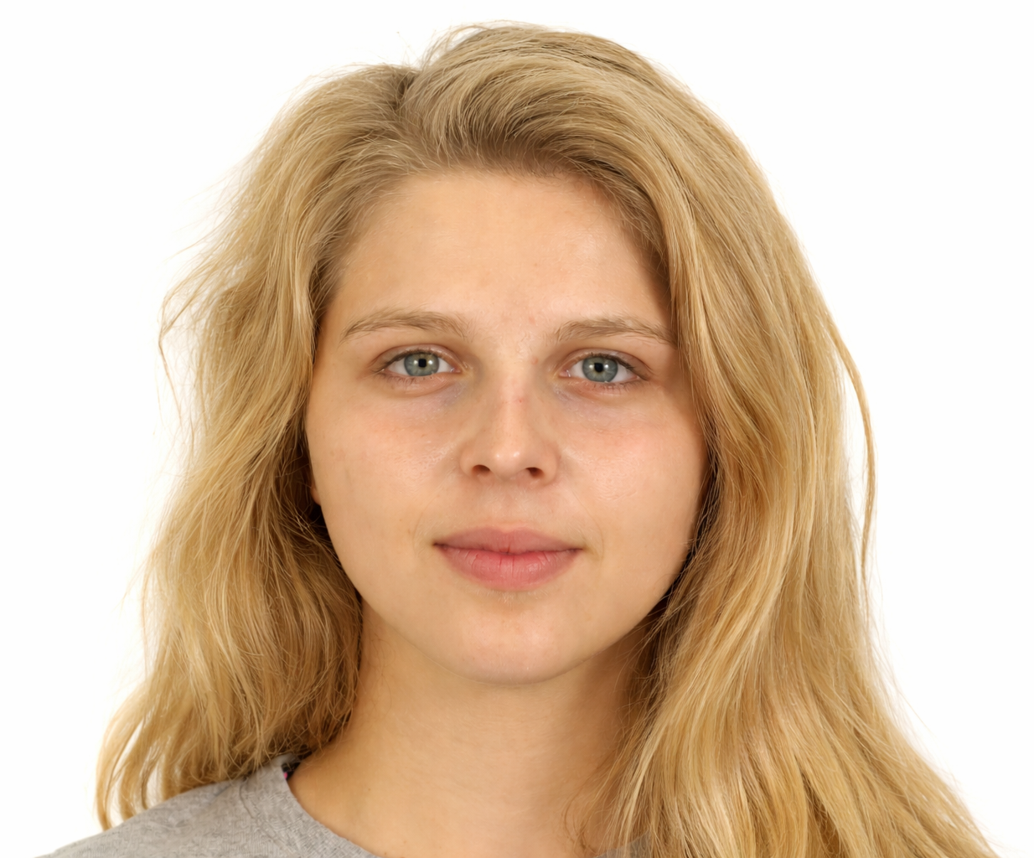
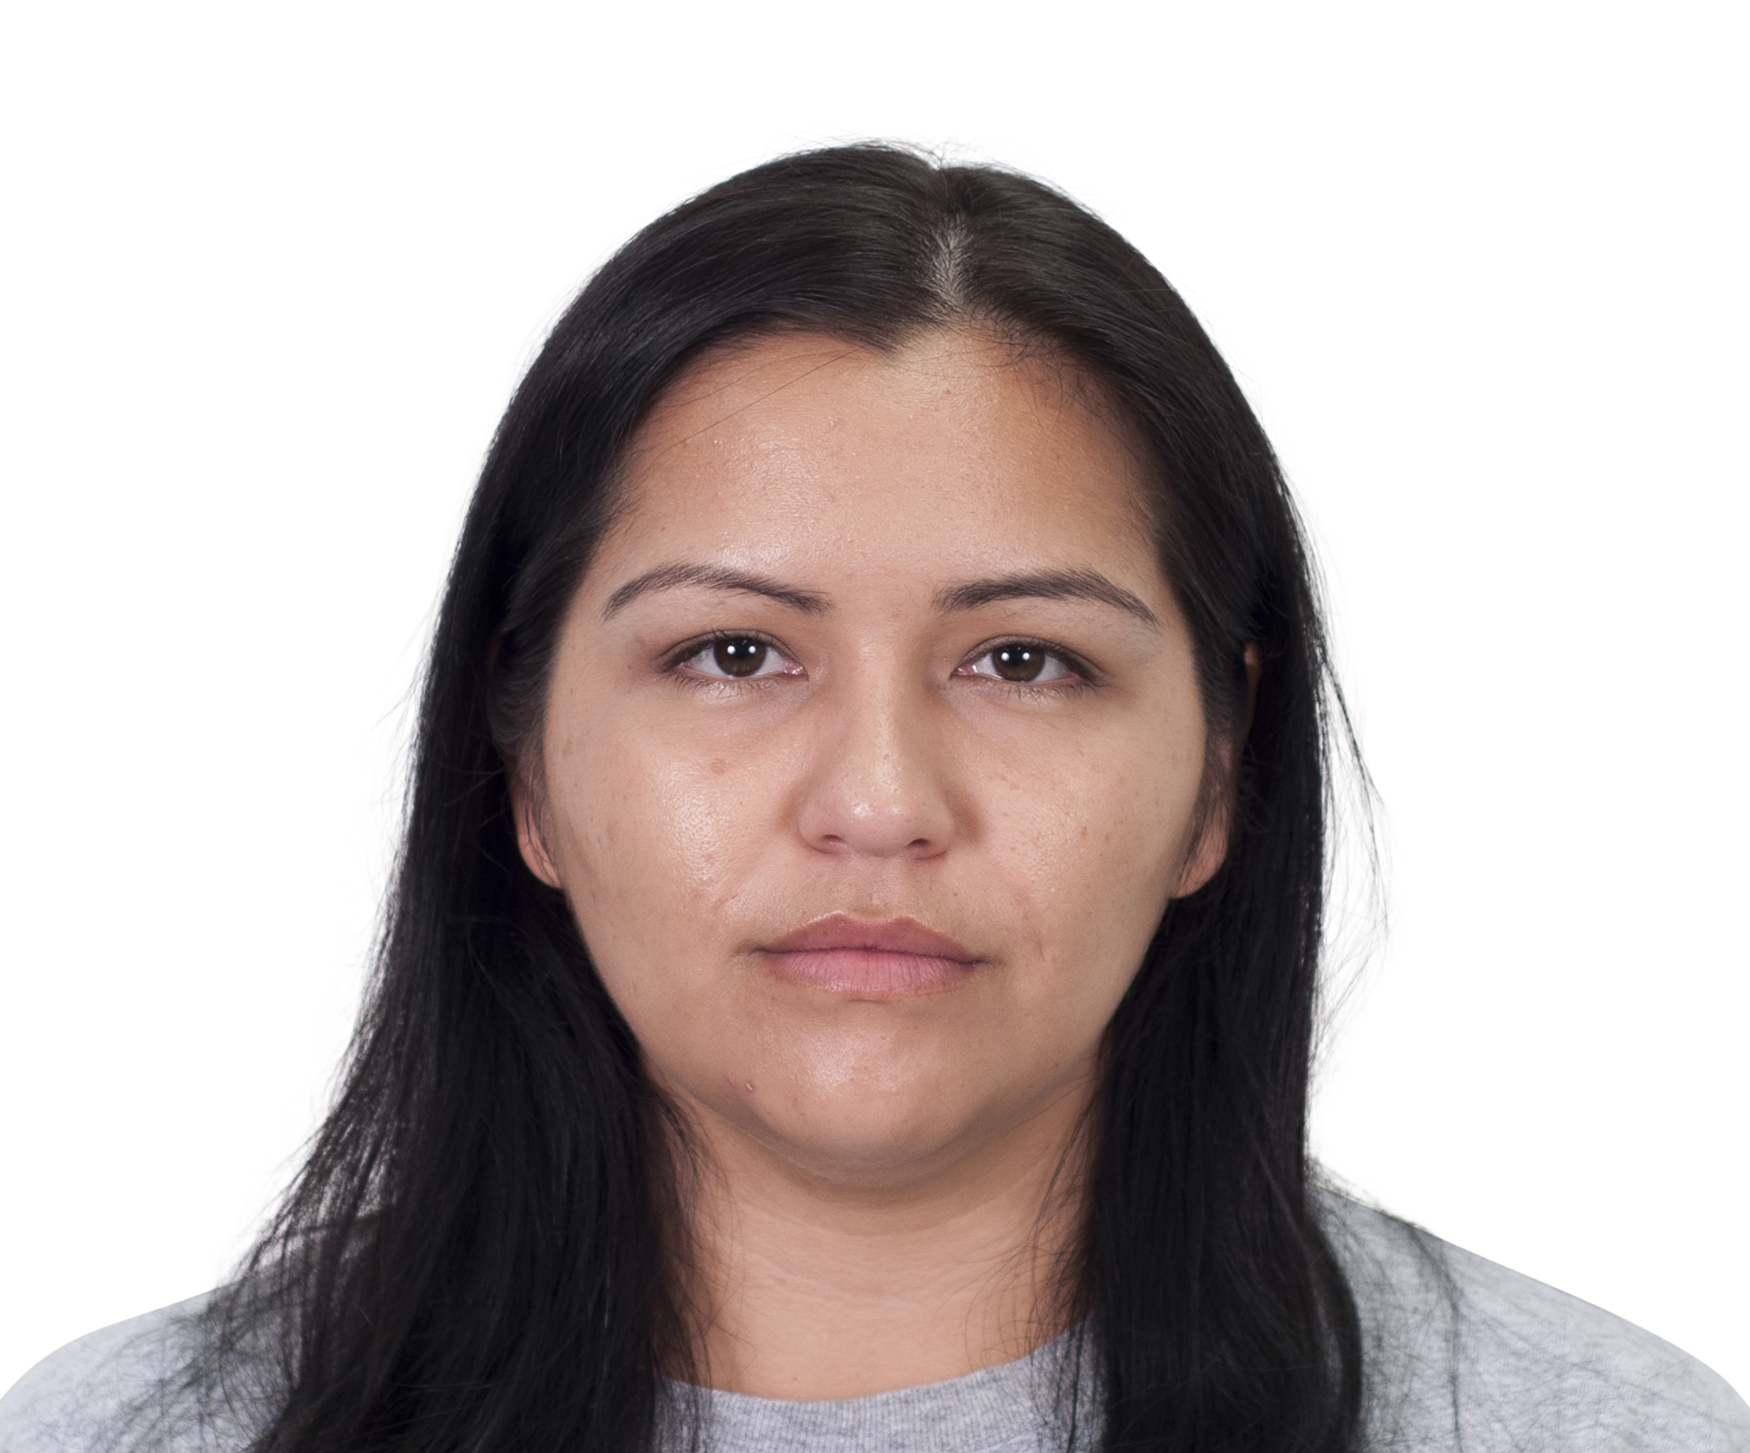
Light Hair
Dark Hair

Slide 4


Slide 5


Slide 6


Slide 7


Slide 8


Slide 9


Slide 10
F
J
Light
Dark

