Slide 1


Slide 2
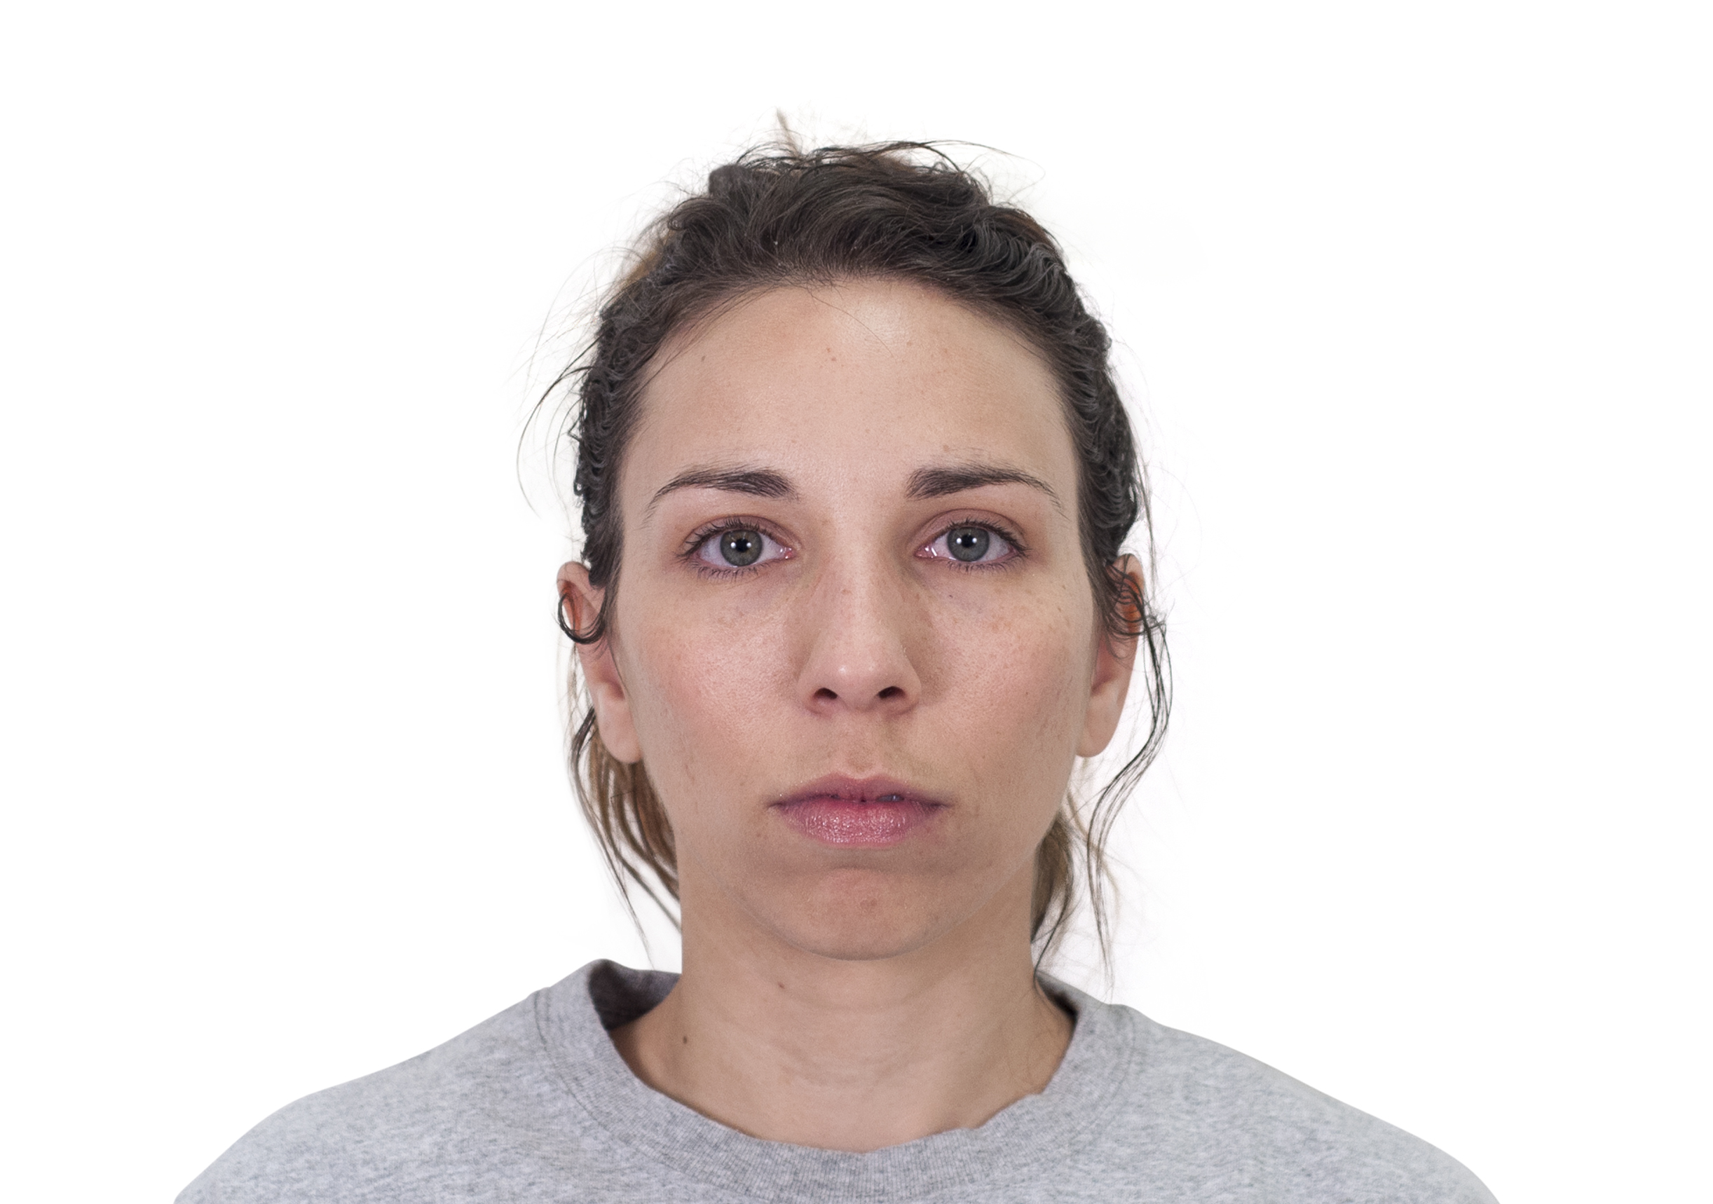
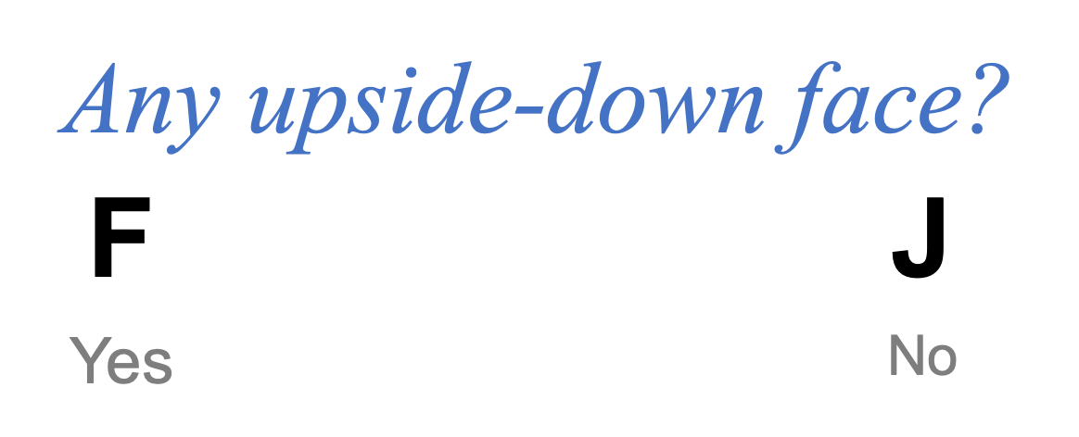

Slide 3
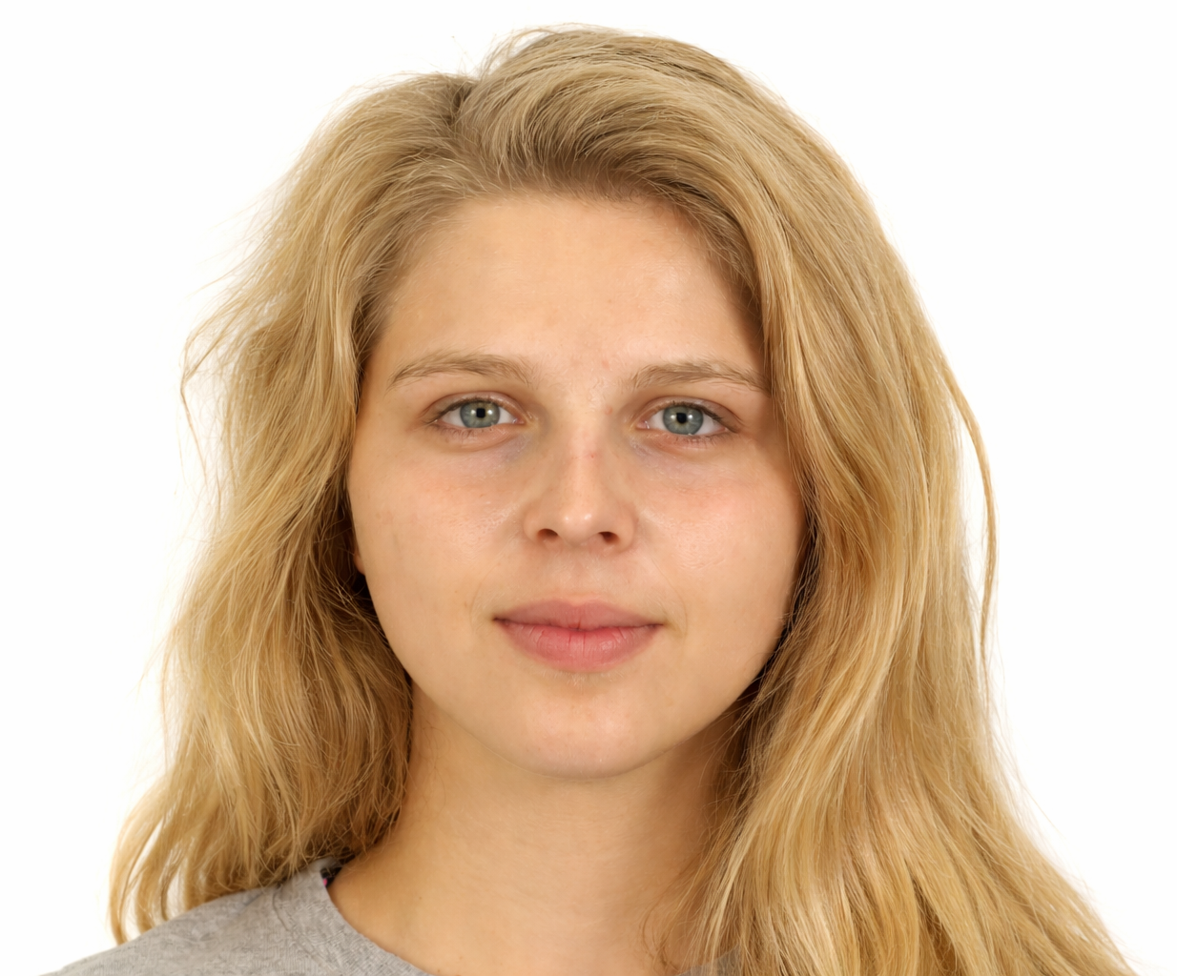
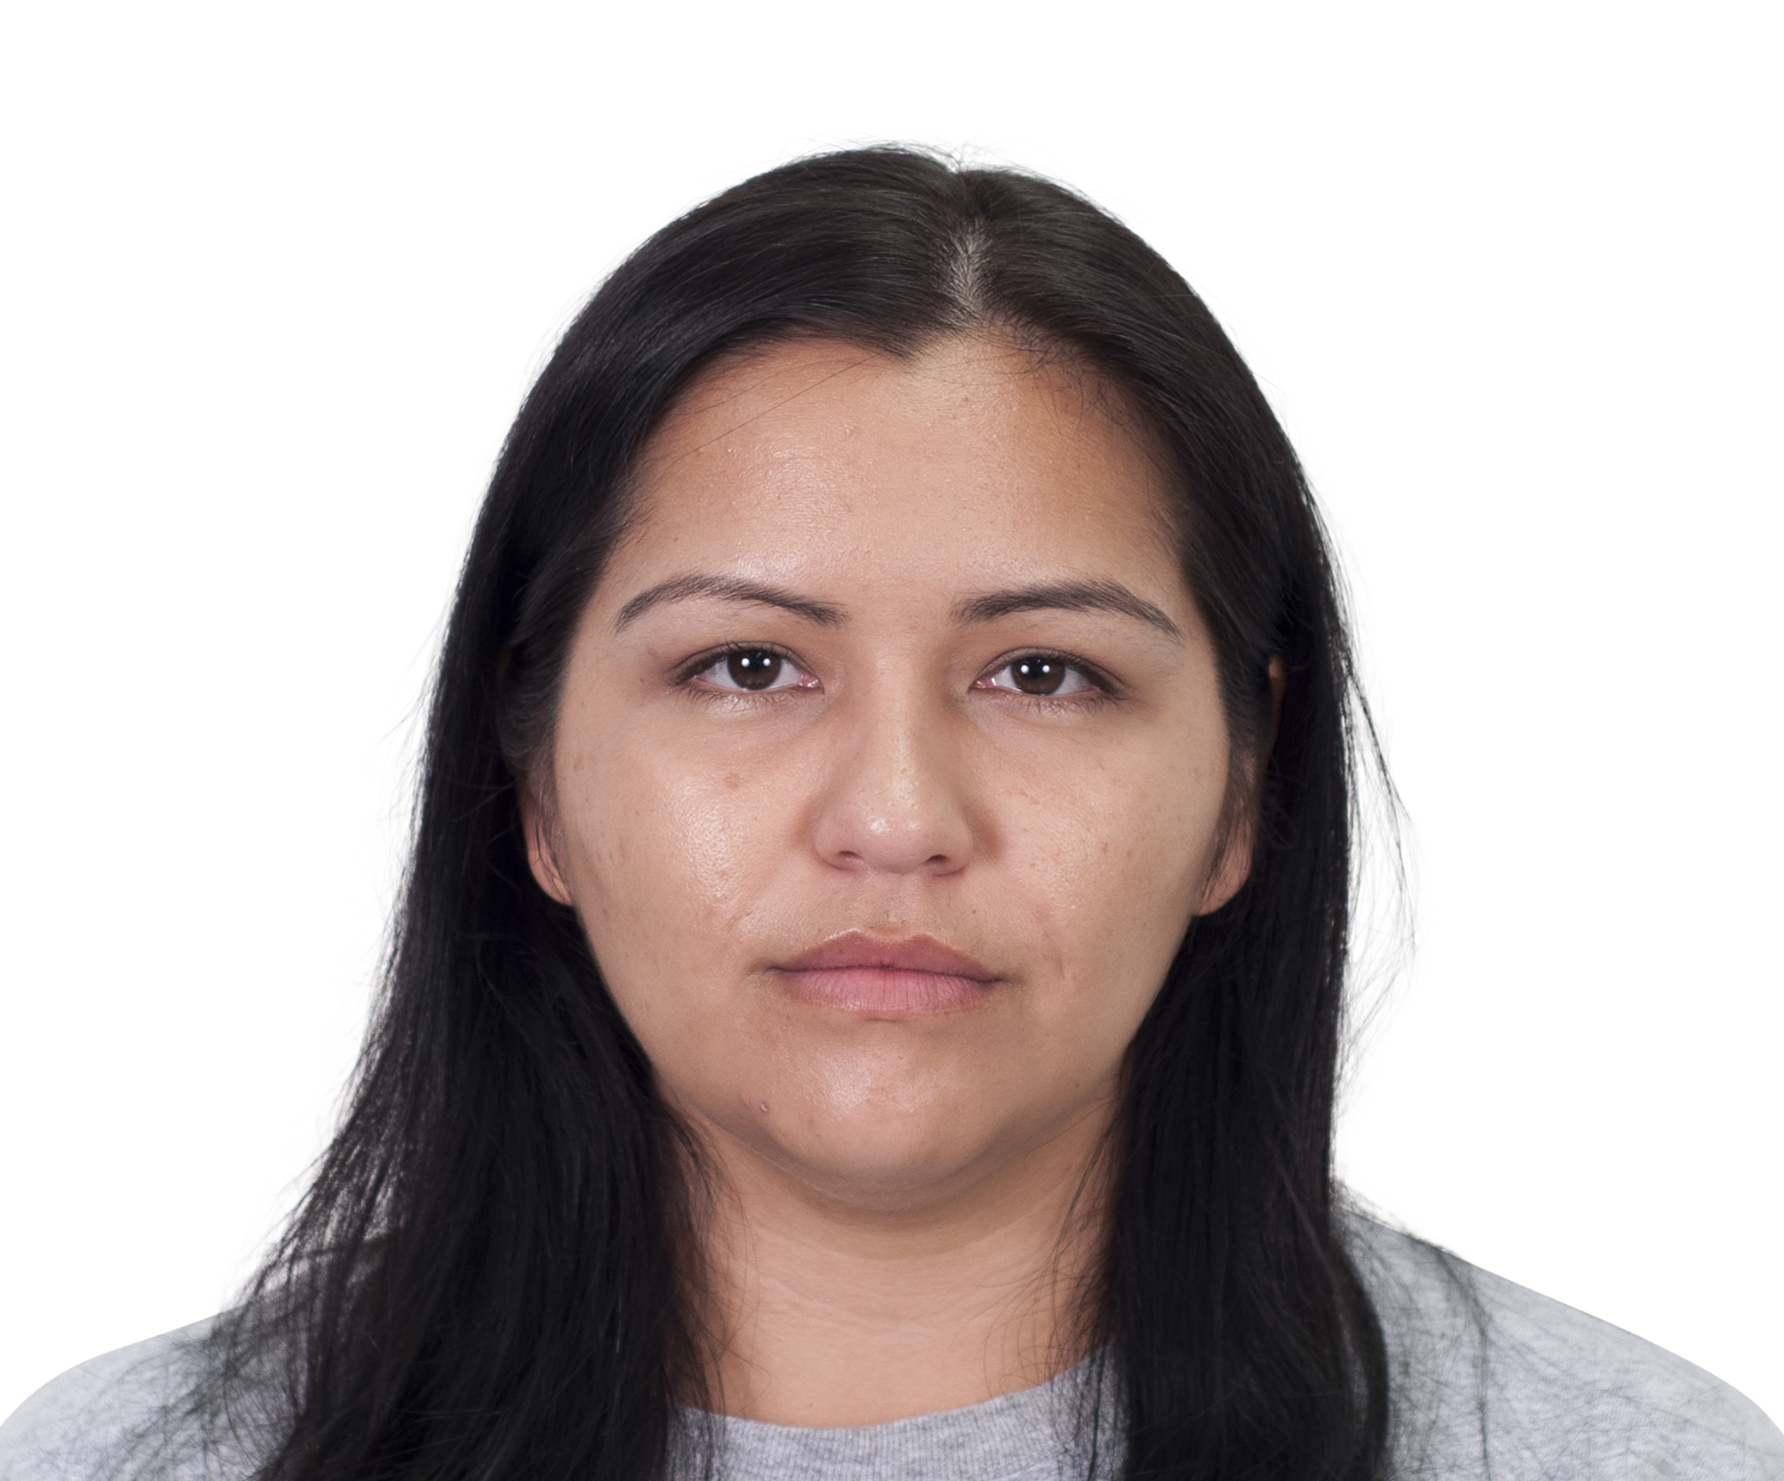
Light Hair
Dark Hair

Slide 4


Slide 5


Slide 6


Slide 7


Slide 8


Slide 9


Slide 10
Any upside-down face?
F
J
Yes
No

