Slide 1


Slide 2
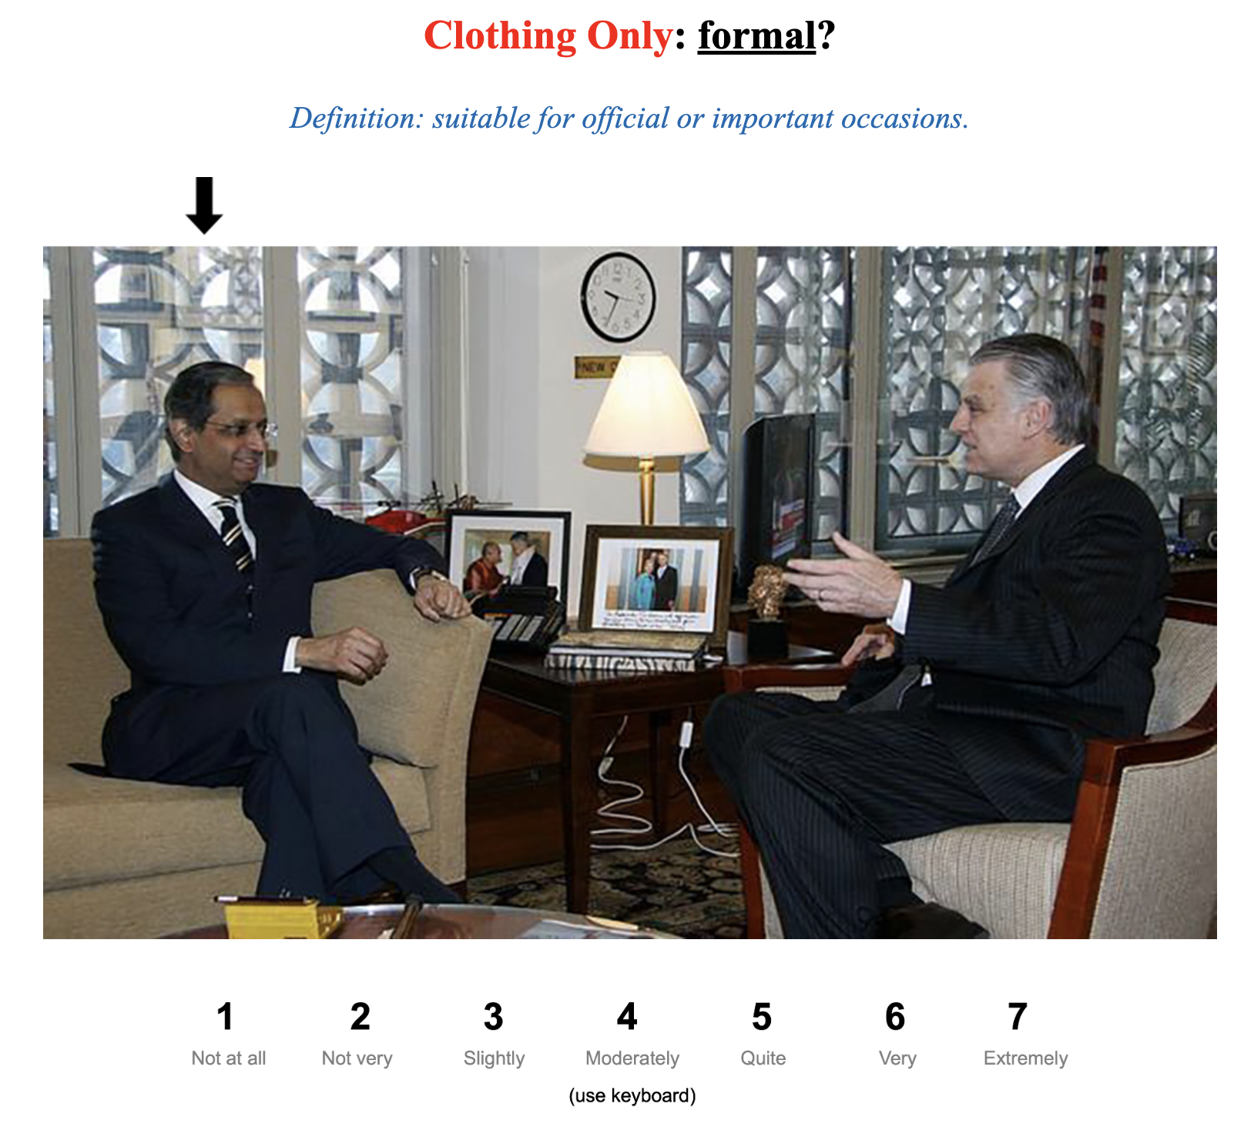

Slide 3
Casual
1
2
3
4
5
6
7
Formal
Very
Casual
Quite Casual
Slightly
Casual
Neutral
Slightly Formal
Quite Formal
Very
Formal
(use keyboard)

Slide 4
Conservative
1
2
3
4
5
6
7
Provocative
Very Conservative
Quite Conservative
Slightly
Conservative
Neutral
Slightly Provocative
Quite Provocative
Very
Provocative
(use keyboard)

Slide 5
Masculine
1
2
3
4
5
6
7
Feminine
Very Masculine
Quite Masculine
Slightly
Masculine
Neutral
Slightly Feminine
Quite Feminine
Very
Feminine
(use keyboard)

Slide 6
1
7
Left image
Right image
(use keyboard)

