Slide 1


Slide 2

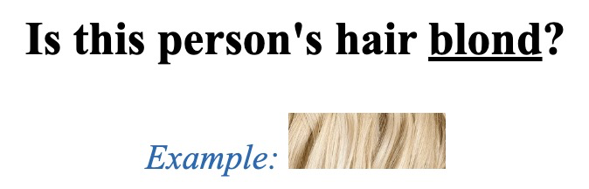
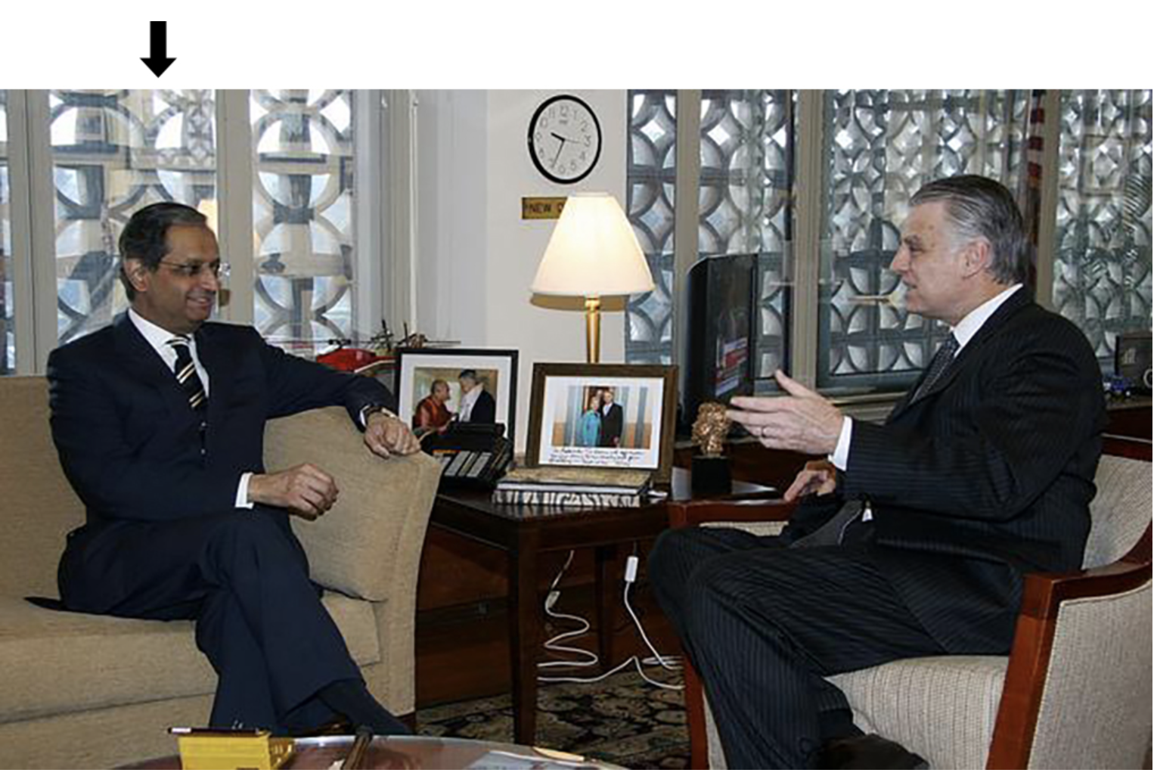
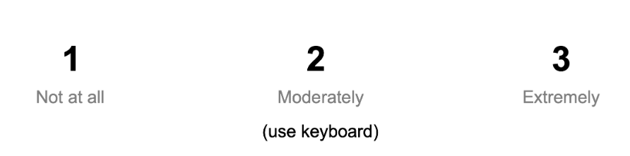

Slide 3
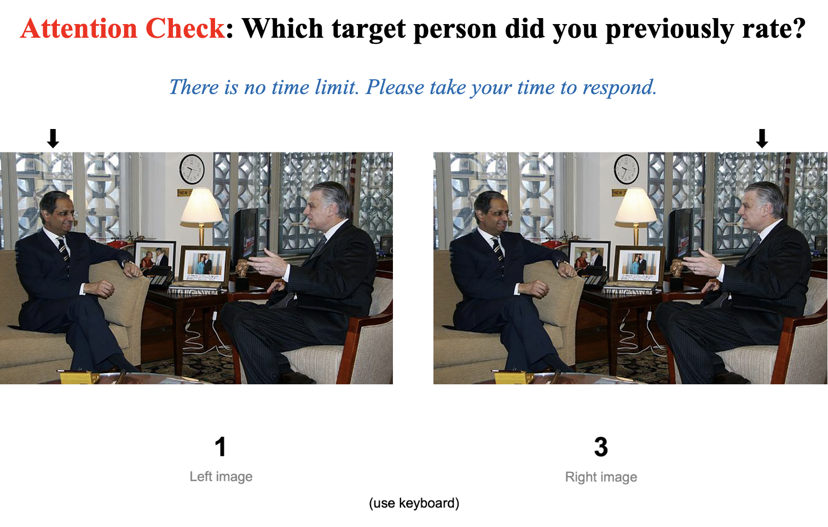

Slide 4
1
2
3
Not at all
Moderately
Extremely
(use keyboard)

Slide 5
1
3
Left image
Right image
(use keyboard)

