Slide 1


Slide 2
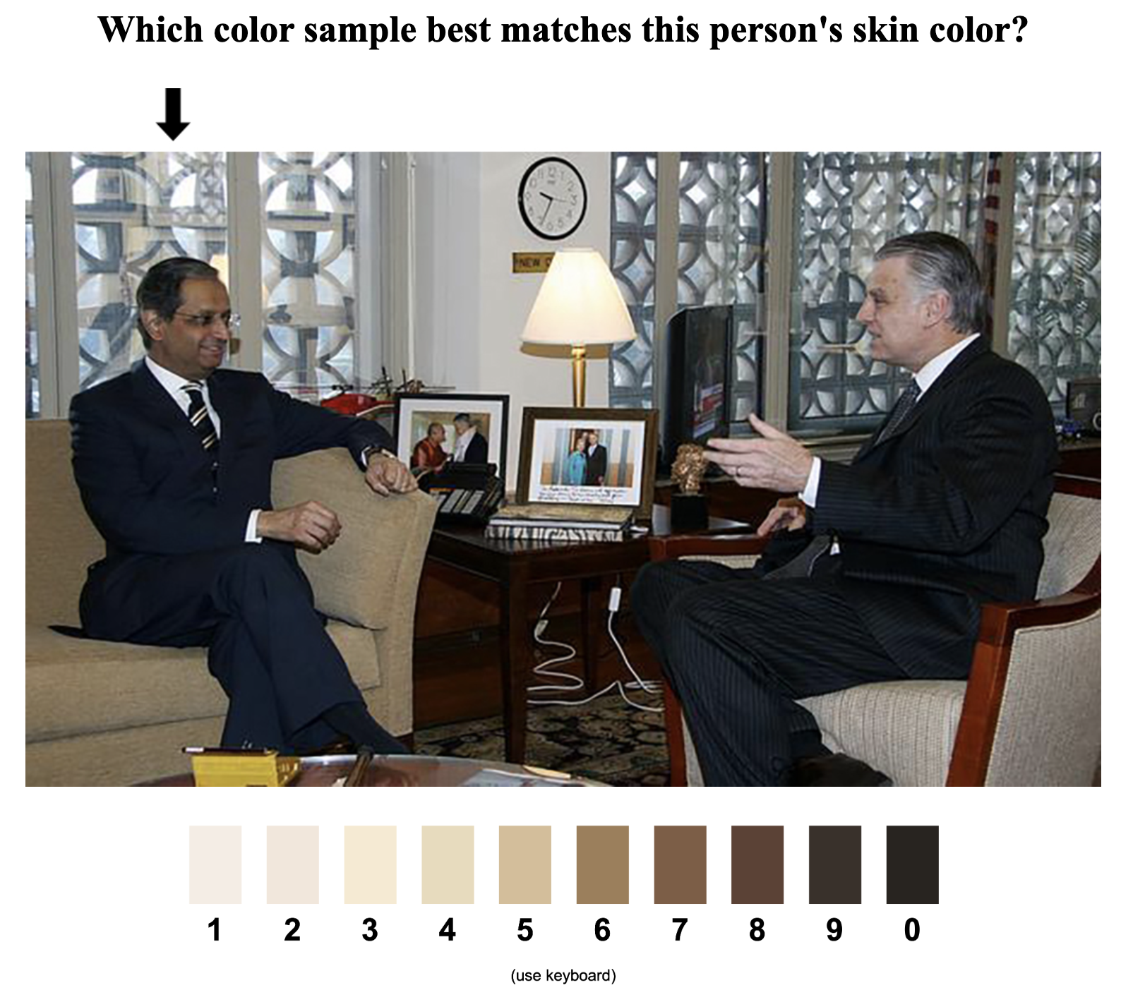

Slide 3
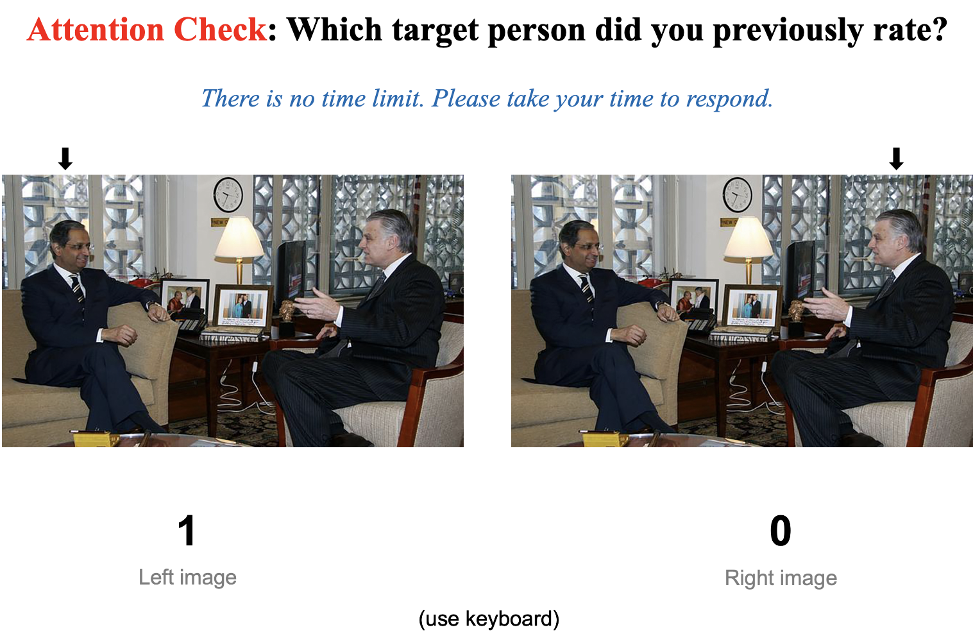

Slide 4
1
2
3
4
5
6
7
8
9
0
(use keyboard)

Slide 5
1
0
Left image
Right image
(use keyboard)

